Slide 1
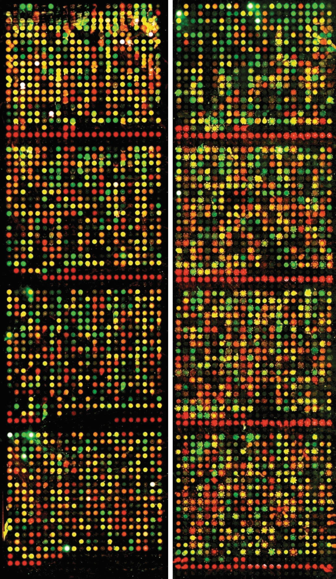
PROJECT PROPOSAL
The role of tissue-restricted antigens (TRAs) in the early embryonic development
Alewtina Towara, Clara Certa, Linda Kaupp, Yaxin Chen
Supervisor: Dr. Maria Dinkelacker
Tutor: Ian Dirk Fichtner
Notes:
Alewtina

Slide 2
Agenda
Biological background
Data sets
Hypothesis and milestones
Team and tasks
Quality control and EDA
Notes:
Alewtina

Slide 3
Biological background
Notes:
Yaxin

Slide 4
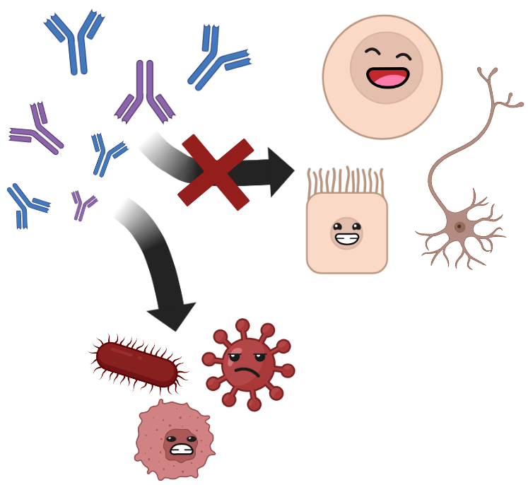
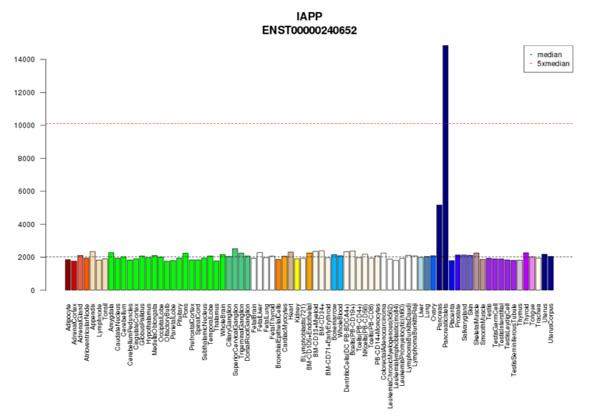
Tissue-restricted antigens (TRAs)
Notes:
Yaxin

Slide 5
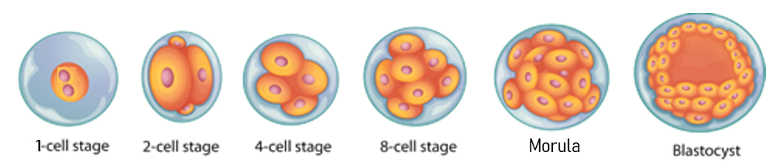
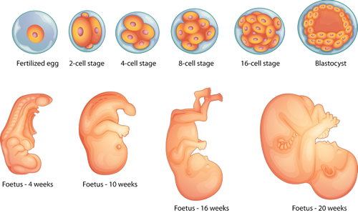
Embryonic development
Notes:
Yaxin

Slide 6
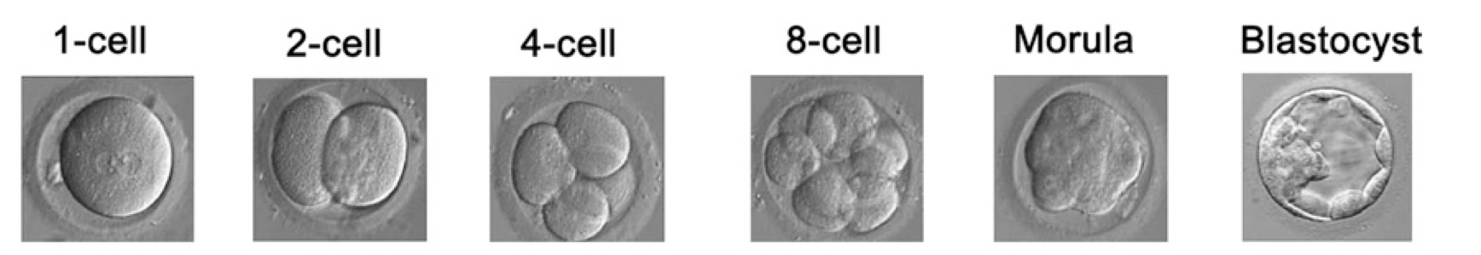
Embryogenesis
Notes:
Yaxin

Slide 7
Our main objective
Identify differentially expressed genes in early embryogenesis and compare them with TRA dataset to determine tissue development.
Notes:
Yaxin

Slide 8
Data sets
Notes:
Alewtina

Slide 9
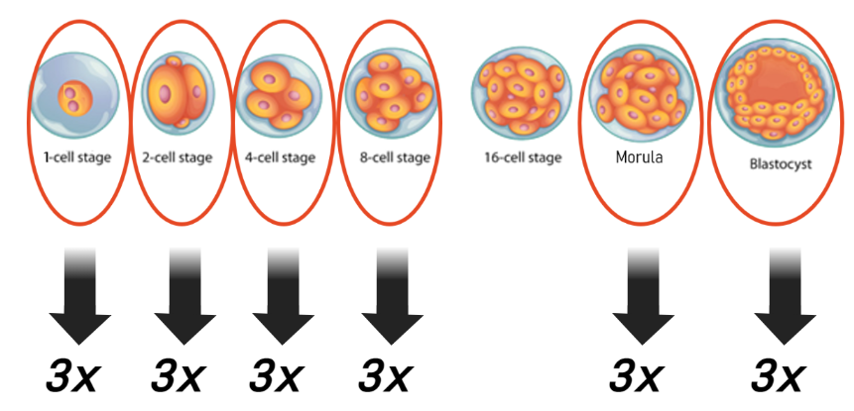
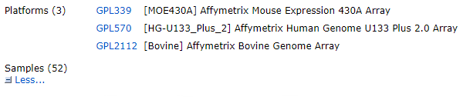
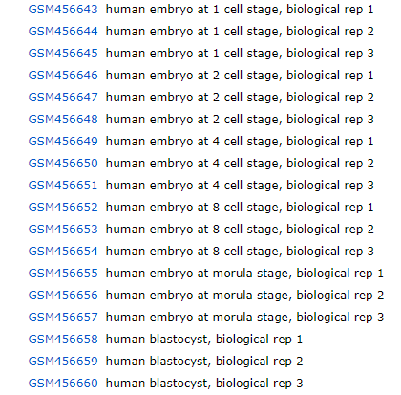
Time course expression data from early Bovine embryo, Human embryo, and Mouse embryo
→only human embryo relevant
Notes:
Alewtina

Slide 10
Datasets of TRAs (Dinkelacker 2007/2019)
six different datasets for TRAs in human and in mouse
expression data in microarrays
RNAseq data (GTEX dataset)
human protein atlas dataset
Notes:
Alewtina

Slide 11
Quality control and EDA
Notes:
Alewtina

Slide 12
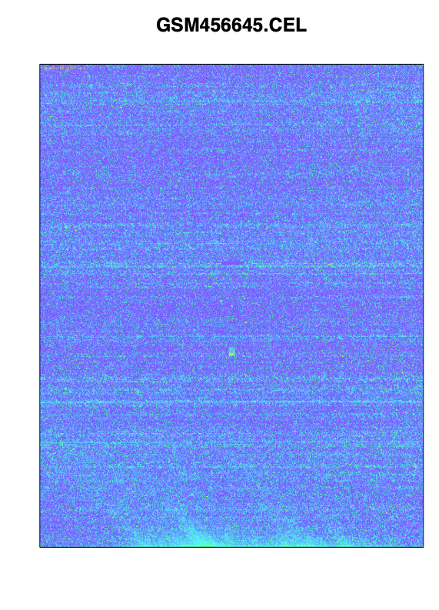
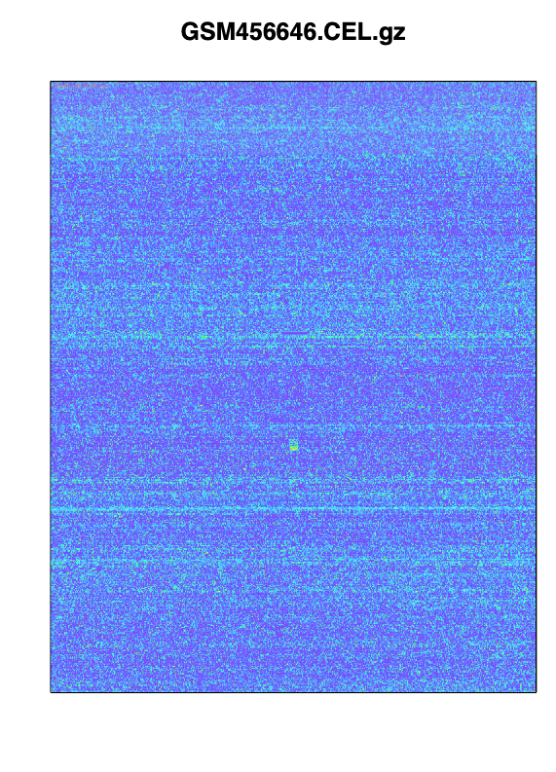
Quality control
Notes:
Alewtina

Slide 13
Quality control
Notes:
Alewtina

Slide 14
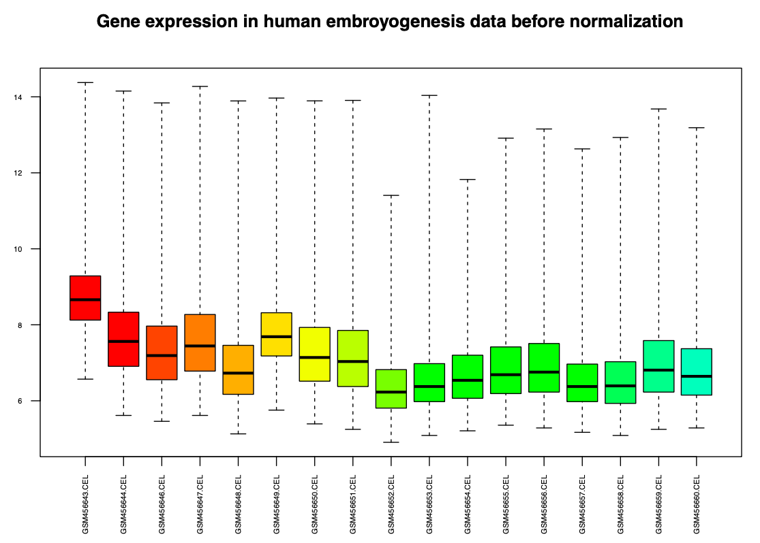
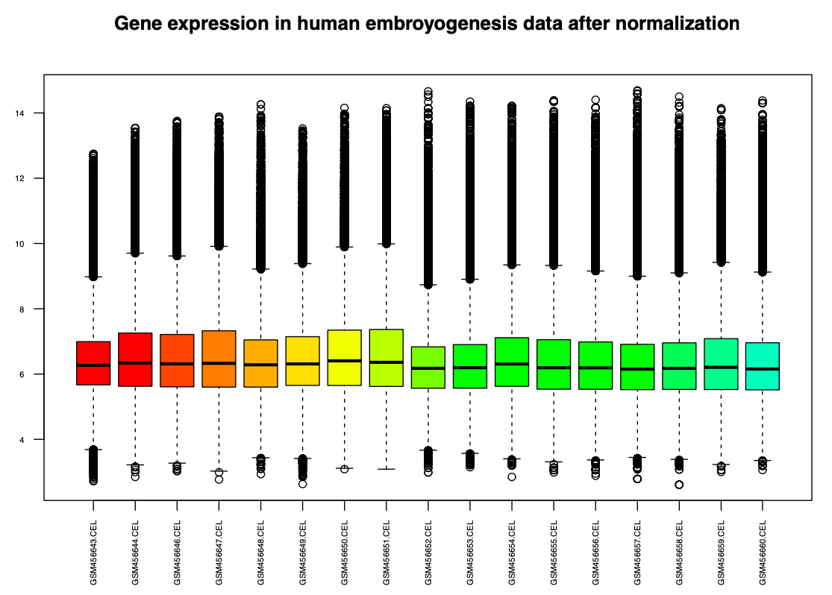
Quality control
Notes:
Clara

Slide 15
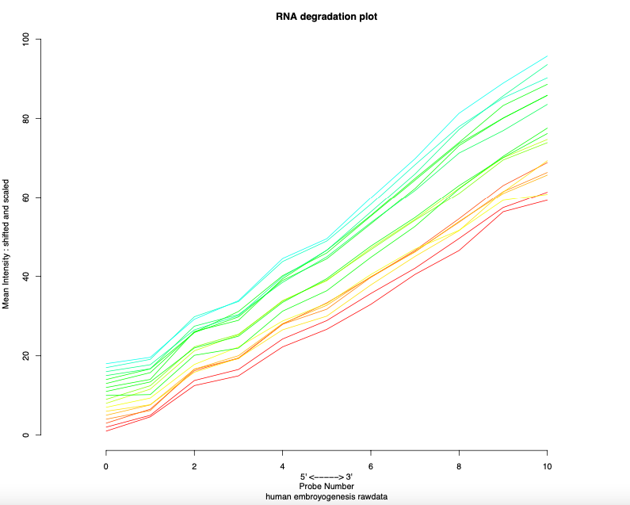
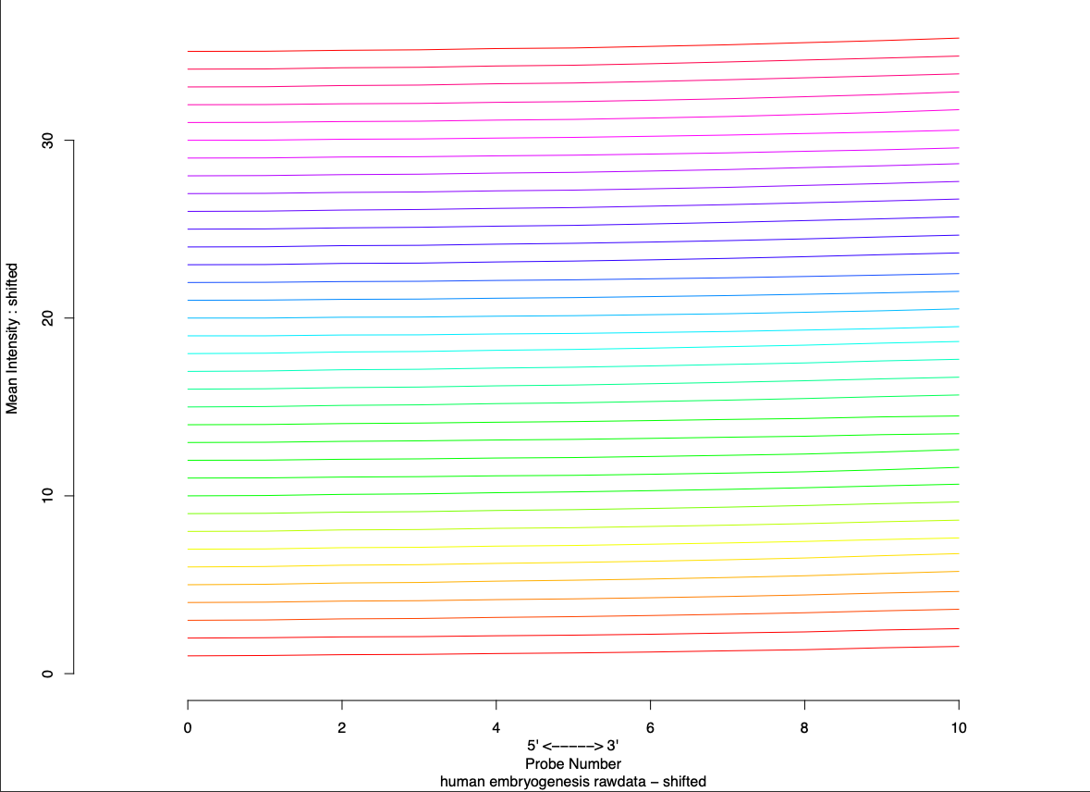
Quality control
Notes:
Clara

Slide 16
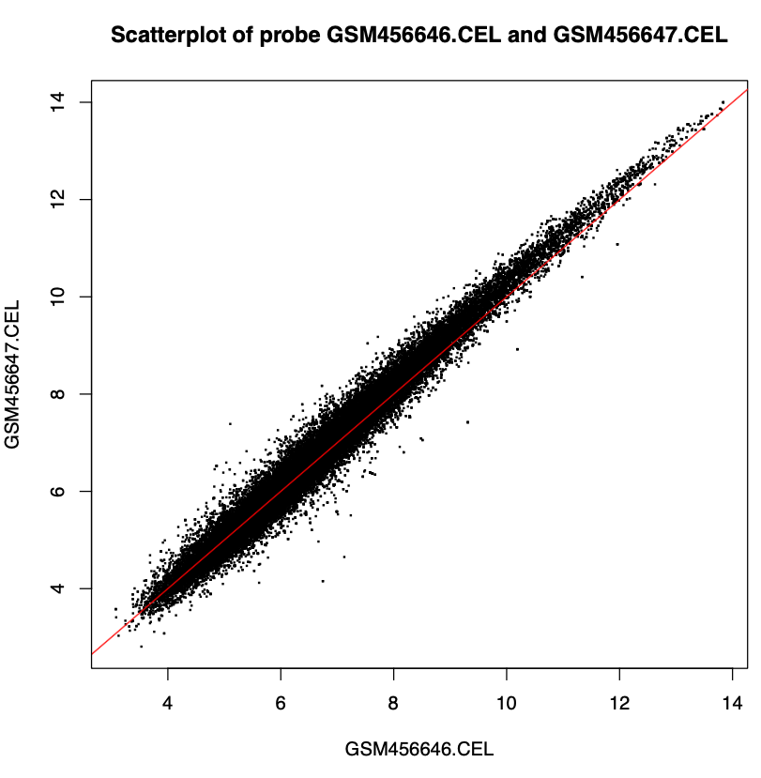
Quality control
Notes:
Clara

Slide 17
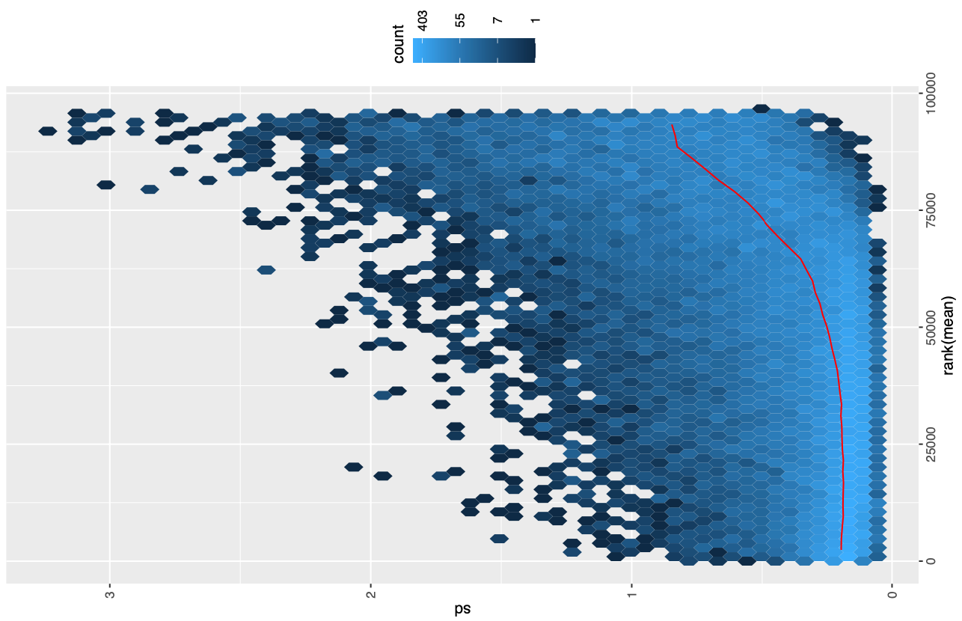
Quality control
Notes:
Clara

Slide 18
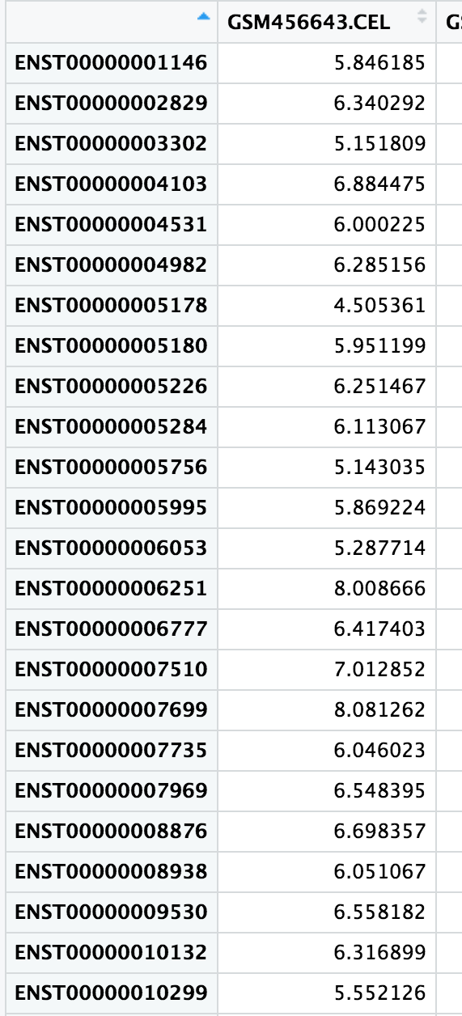
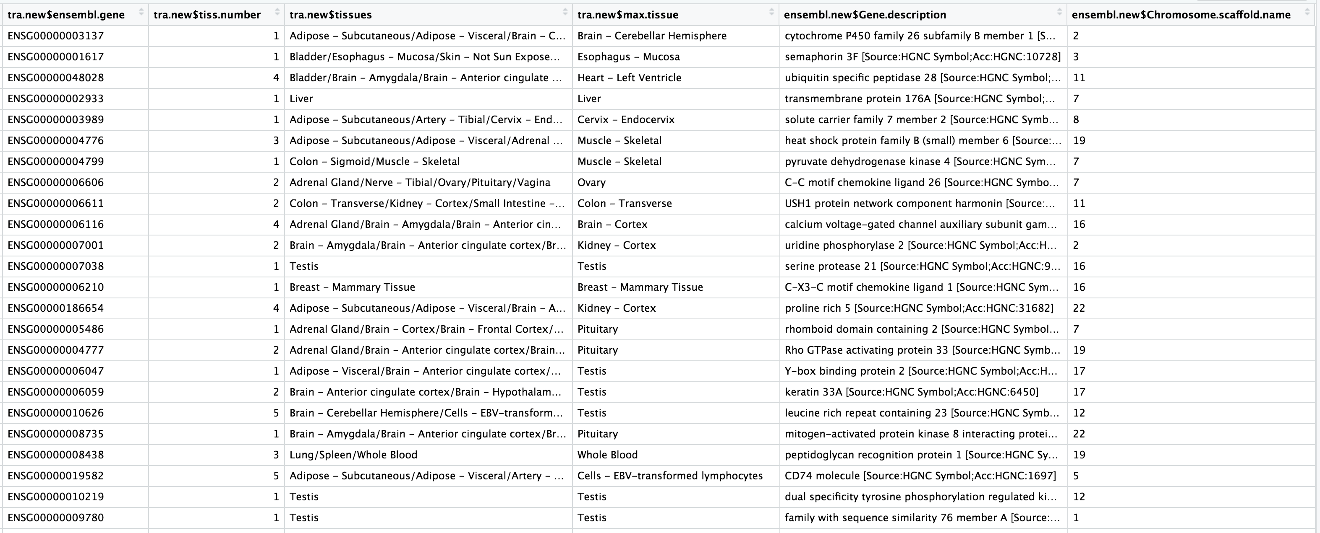
Exploratory data analysis
…
Notes:
Clara

Slide 19
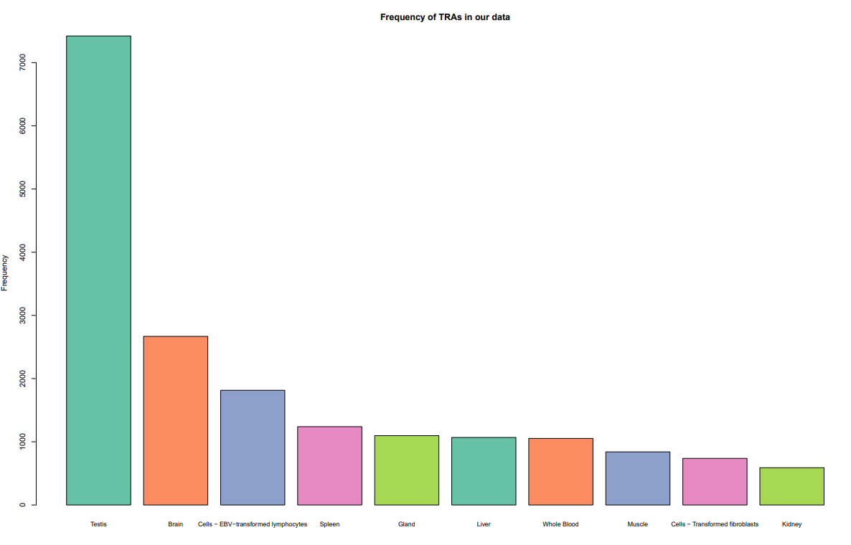
Exploratory data analysis
Notes:
Clara

Slide 20
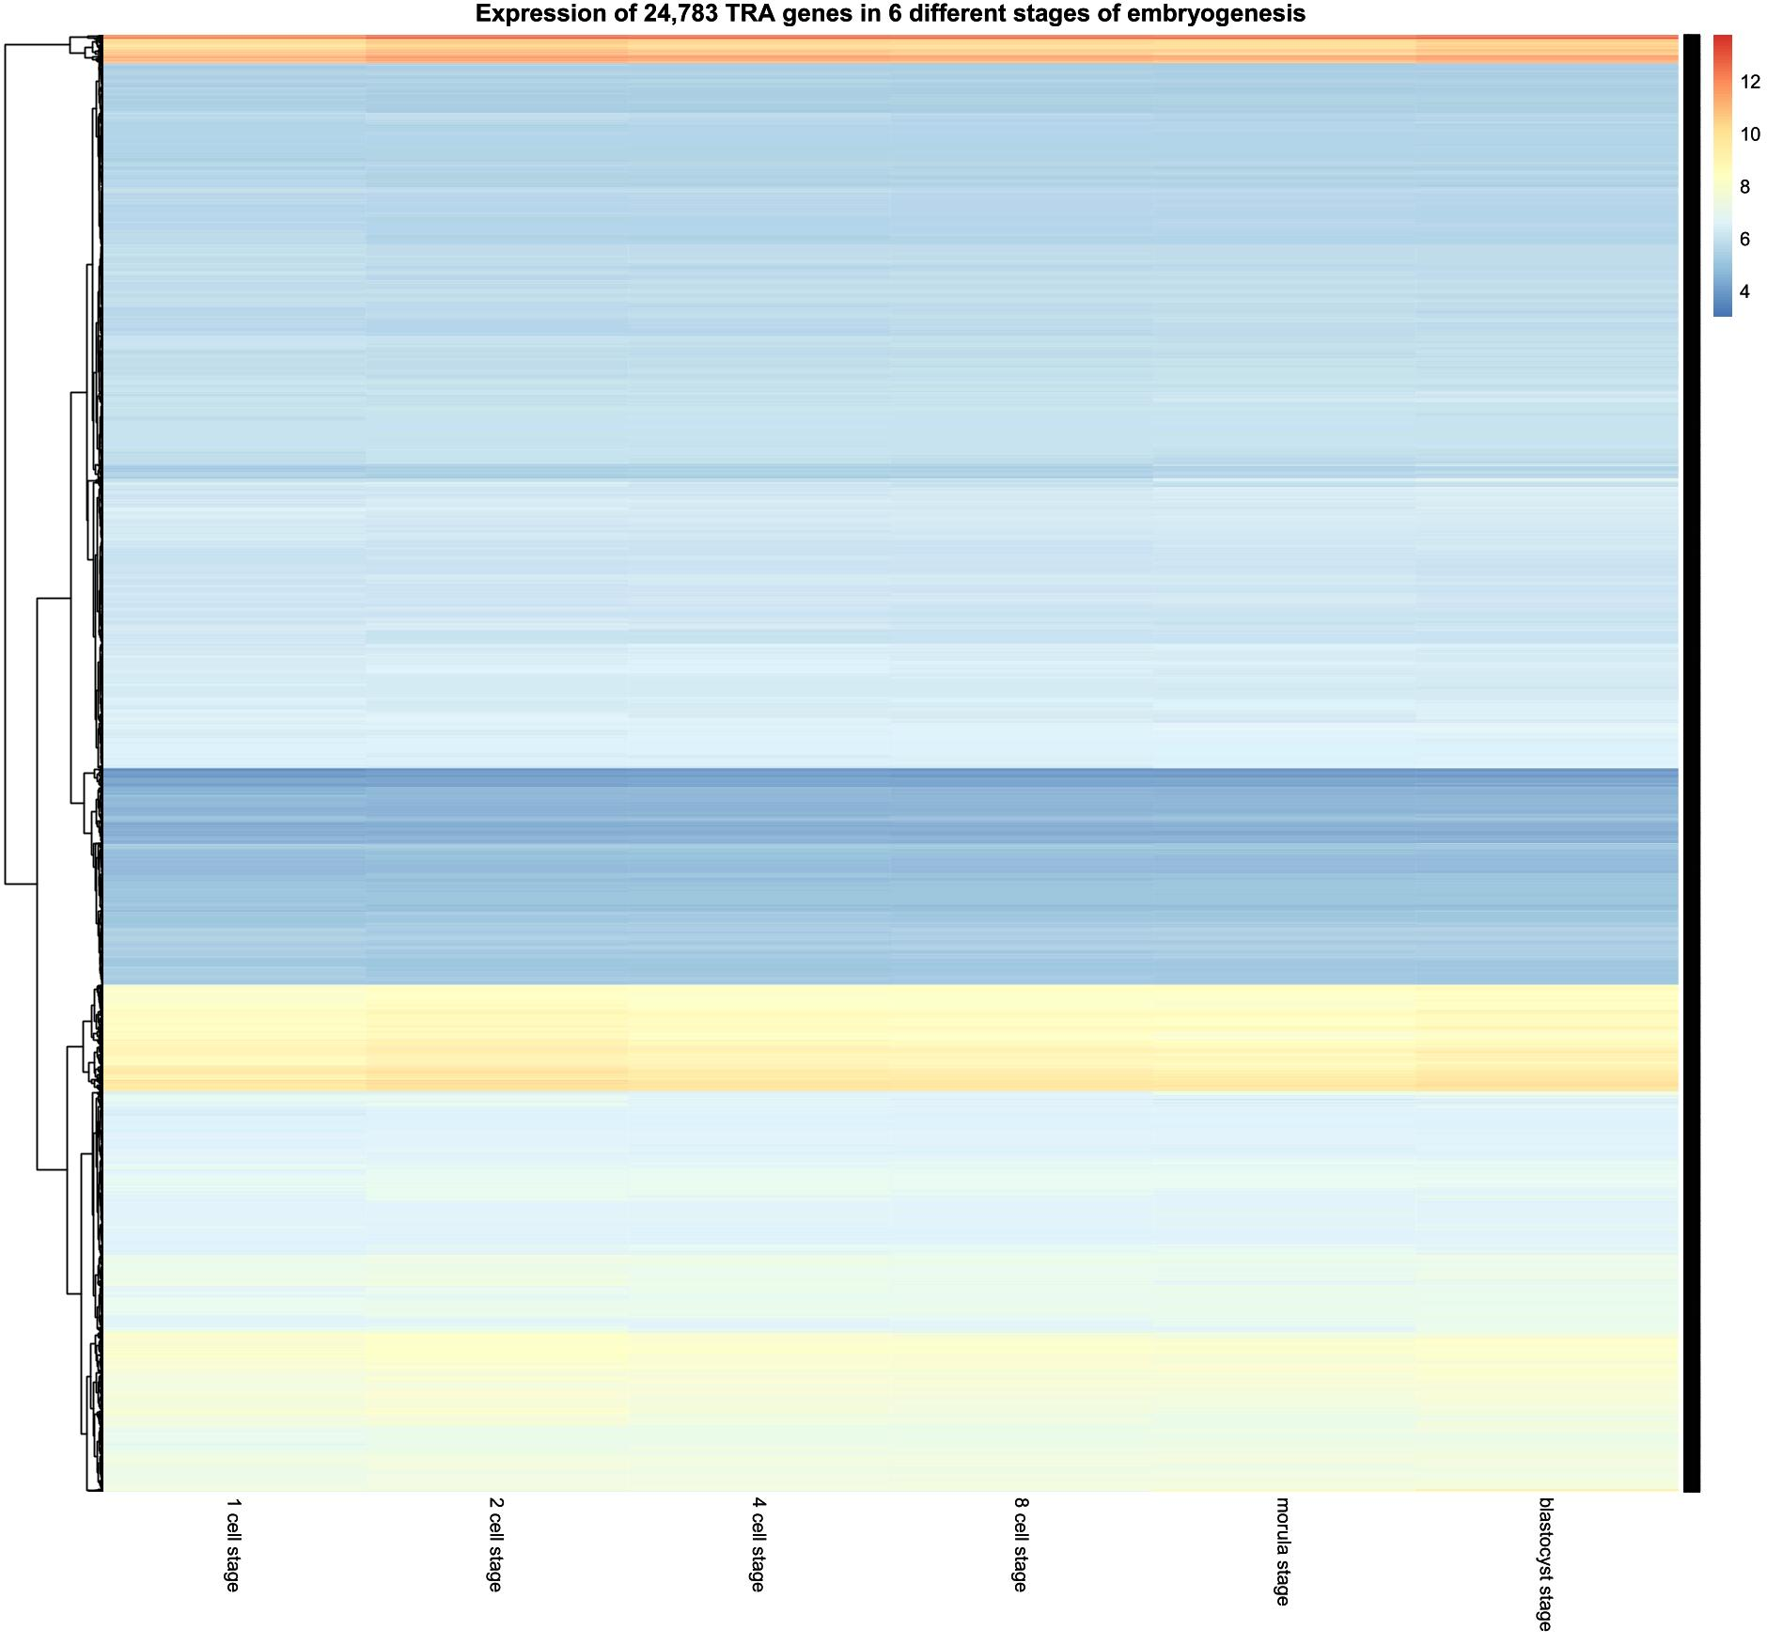
Exploratory data analysis
Notes:
Clara

Slide 21
Hypothesis and milestones
Notes:
Linda

Slide 22
Hypothesis
Investigate differential expression of TRAs in dataset
Expectation: No differential expression due to early stage investigation
Notes:
Linda

Slide 23
Hypothesis
Investigate differential expression of TRAs in dataset
Which genes are differentially expressed?
What is the biological function ?
Investigate differential expression of Chemokines and their receptors
Expectation: e.g. CCR3 is differentially expressed due to relevance for implantation
Notes:
Linda

Slide 24
Hypothesis
Investigate differential expression of TRAs in dataset
Which genes are differentially expressed?
What is the biological function ?
Investigate differential expression of Chemokines and their receptors
What is the biological function?
Notes:
Linda

Slide 25
Hypothesis
Investigate differential expression of TRAs in dataset
Which genes are differentially expressed?
What is the biological function ?
Investigate differential expression of Chemokines and their receptors
What is the biological function?
Test for correlation between Chemokine(receptor) expression and expression of downstream pathway proteins
Notes:
Linda

Slide 26




Milestones
MILESTONE 01
Read in data,
Cleaning and quality control
MILESTONE 03
Extract TRAs,
Extract chemokines and receptors
MILESTONE 02
Analysis of adj.pvalues,
kmeans clustering,
heatmaps
MILESTONE 04
Biological question
and report
Notes:
Linda

Slide 27
Schedule
QC & EDA
Extract TRAs & chemokines
Report & final presentation
Limma analysis, k-means & heatmaps
Research biological relations
18.05.22
Project proposal
20.07.22
Final presentation
KW | 19 | 20 | 21 | 22 | 23 | 24 | 25 | 26 | 27 | 28 | 29
Notes:
Linda

Slide 28
Team and tasks
Notes:
Clara

Slide 29



Team structure
Communication: via Whatsapp and Discord
Coding lab: monday, 1 pm
Task management: Googledocs
Notes:
Clara

Slide 30


Notes:
Clara

Slide 31
Literature
Dinkelacker 2019. Chromosomal clustering of tissue restricted antigens, Dissertation, University Heidelberg, Germany.
Dinkelacker 2007. A database of genes that are expressed in a tissue-restricted manner to analyse promiscous gene expression in medullary thymic epithelial cells. Diplomarbeit, Albert-Ludwigs-Universität, Freiburg, Germany.
Xie D, Chen CC, Ptaszek LM, Xiao S, Cao X, Fang F, Ng HH, Lewin HA, Cowan C, Zhong S. Rewirable gene regulatory networks in the preimplantation embryonic development of three mammalian species. Genome Res. 2010 Jun;20(6):804-15. doi: 10.1101/gr.100594.109. Epub 2010 Mar 10. PMID: 20219939; PMCID: PMC2877577.
Li H, Meng YH, Shang WQ, Liu LB, Chen X, Yuan MM, Jin LP, Li MQ, Li DJ. Chemokine CCL24 promotes the growth and invasiveness of trophoblasts through ERK1/2 and PI3K signaling pathways in human early pregnancy. Reproduction. 2015 Nov;150(5):417-27. doi: 10.1530/REP-15-0119. Epub 2015 Aug 27. PMID: 26316550.
https://www.drgururpolat.com/de/in-vitro-fertilisation/entwicklung-vom-embryo/
https://www.ncbi.nlm.nih.gov/geo/query/acc.cgi?acc=GSE18290

Slide 32
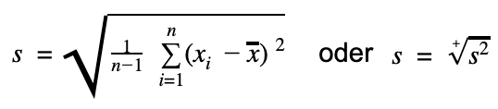
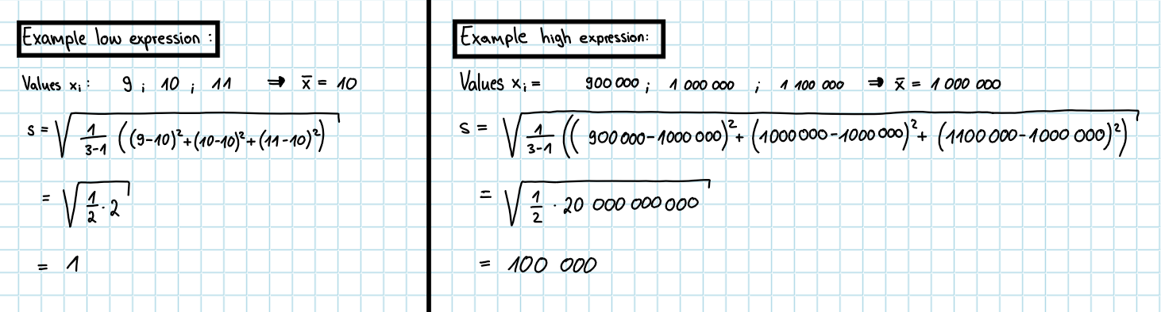
Explanation meansd plot
Same relative deviation from mean but different standard deviation for low and high expression levels
Additionally, differentially expressed genes could also be an explanation

